Slide 1
An Analysis of Crime Rates in Ireland and Prediction based on Social & Economic Factors
Author: Gavin O’Neill
Supervisor: john mcauley
18th January 2017

Slide 2
Project Objectives
Analyse the crime rate in Ireland
Determine which socioeconomic factors are influential
Build a predictive model based on these factors
Train and test the model
Outline any findings

Slide 3
Background
Crime puts a huge burden on society
Financial costs, resources, psychological effects
How can we fight it?
Instead of being reactive, be proactive
Find causes and prevent it

Slide 4
Research findings
Reasons are not always obvious
Freakonomics and Arab Spring
Predictive policing is already in use today

Slide 5
Technologies used
Microsoft Excel – Data collection
Tableau – Exploratory analysis
R via RStudio – further analysis and predictive model

Slide 6
Data Summary
Sources: CSO, An Garda Siochana, HSE, Eurostat
20+ csv files
26 variables: 4 dimension and 22 measurable including target
Edited and combined into a main dataset

Slide 7
Data Preparation
Full set included years 2003 – 2015
Data quality report
Problem: 10 variables with +5% missing values
Reduce years to 2007 – 2014
Resulting dataset has only 2 variables with missing values

Slide 8
Initial Exploration
Using Tableau for visualisation
Gain an insight into the data
Learn about any trends
Assist decision making in modelling stage

Slide 9
Mean Disposable Income vs Number of Offences

Slide 10
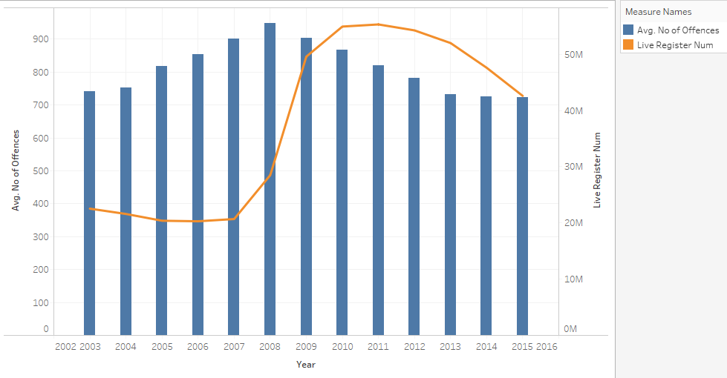
Live Register Number vs Number of Offences

Slide 11
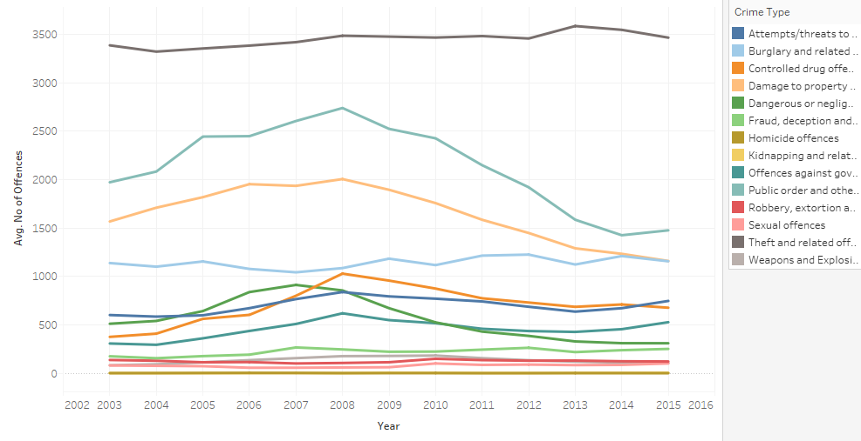
Trends in different crimes

Slide 12
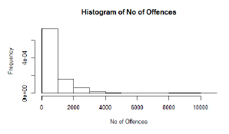
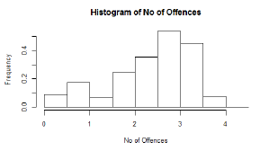
Data Pre-Processing

Slide 13
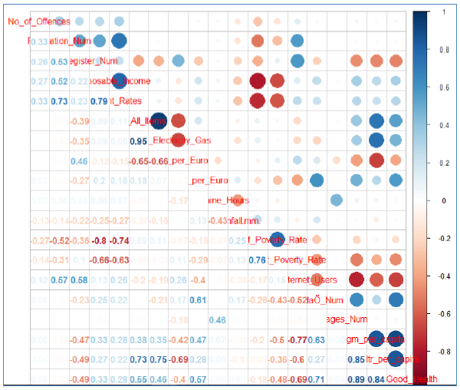
Data Pre-Processing

Slide 14
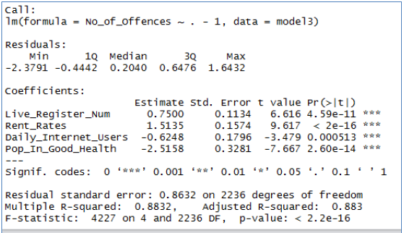
Final Model

Slide 15
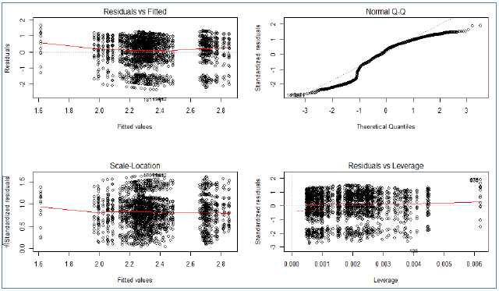
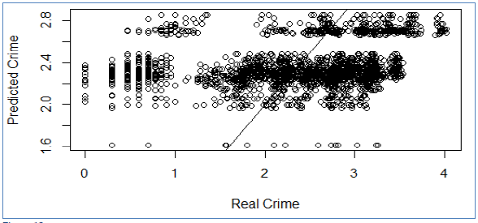
Diagnostic Plots

Slide 16
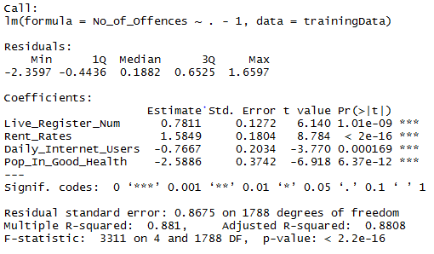
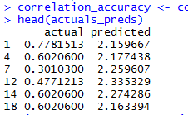
Training and testing

Slide 17
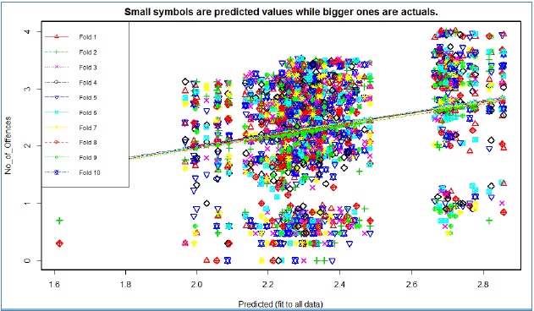
K-fold cross validation

Slide 18
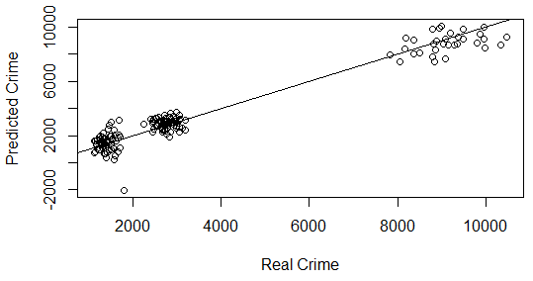
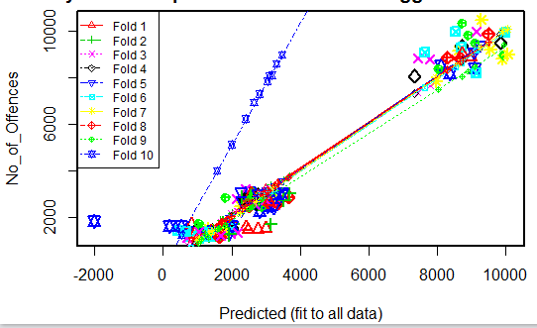
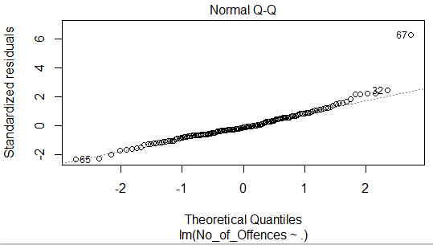
Plots and k-fold cross validation results when target is Theft offences only

Slide 19
Conclusion
Social and economic factors do have an effect on the crime rate
They can be used to predict future trends
It would be possible to model accurately with more time
A better dataset structure is needed for any future work

